Slide 1
Breaking Boundaries: Uncovering Patterns and Trends in Cricket through Advanced Data Analytics
Database & Analytics Programming

Slide 2




TEAM
Shreyal Kulaye
Anish Romario
x22155791
x20190841
Sonal Puradkar
Nandheeswari Rajendran
x22130250
x22132210

Slide 3
Newness about our model
Dataset 1
ESPN CRICKET Info
Dataset 2
Region based stats
Won lost, Best batsman, bowler, match statistics between teams
Dataset 3
Focus on Particular teams(India Vs Australia)
Dataset 4
IPL Matches
RCB

Slide 4

“Alone, we can do so little; together, we can do so much.”

Slide 5
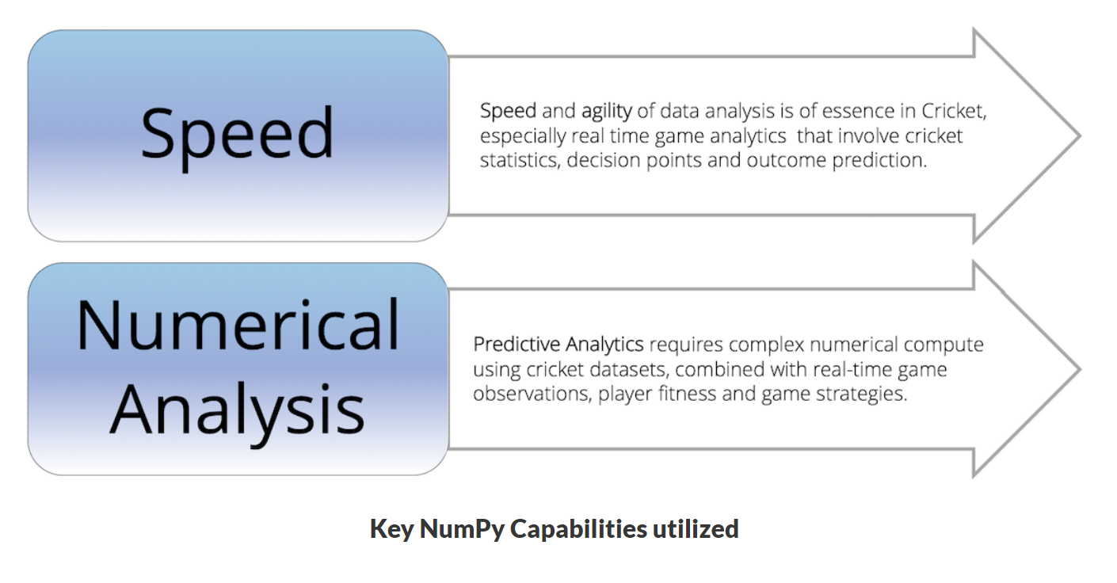

Slide 6

Introduction
Why Cricket Data Analytics
Performance moving average
score forecasting
gaining insights into fitness and performance of a player against different opposition,
player contribution to wins and losses for making strategic decisions on team composition
IMP Steps
New Libraries
Statistical Analysis
Data Visualization

Slide 7

CLOUD BASED
01
02
03
Google Colaboratory
Nosql Database Connections
SQL Database Connections

Slide 8
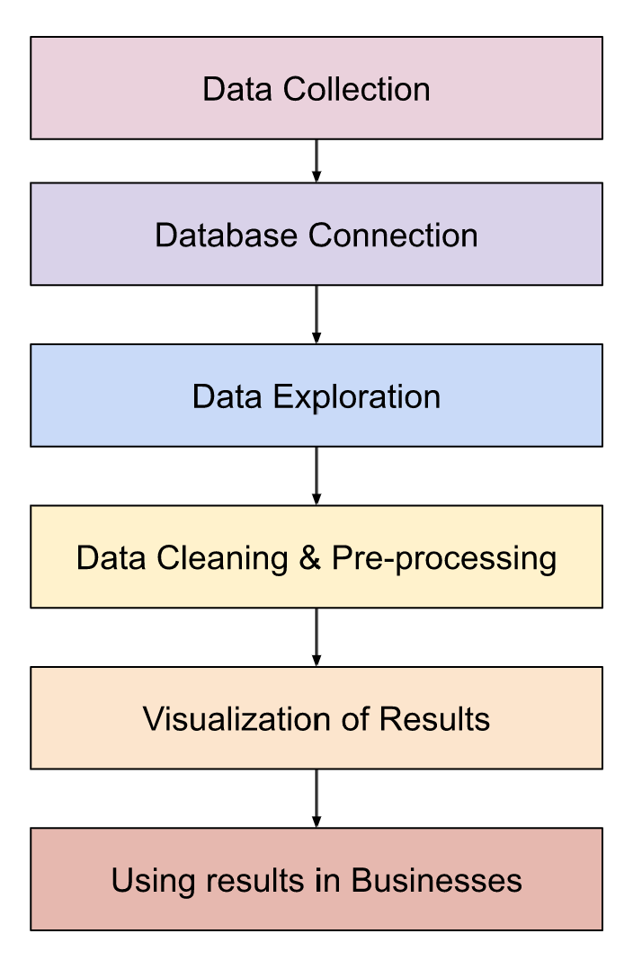
Flow of Model

Slide 9

01
ODI real time dataset
ESPN CRICKET DATA - Live cricket scores, cricket updates of upcoming International, domestic and T20 matches. Catch all the latest videos, news about cricket

Slide 10
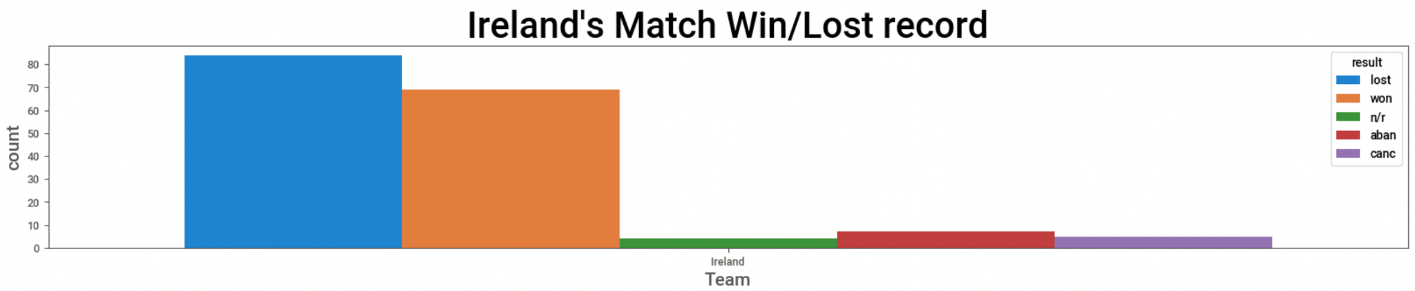
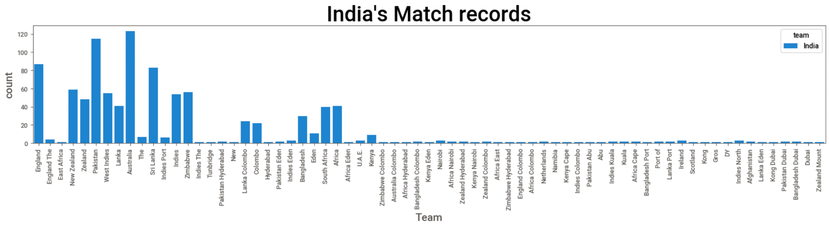
Analytics
Won/lost the batting first
Who won/lost the toss,
The opposite teams every match
The grounds where all the matches were played
Result of the match

Slide 11
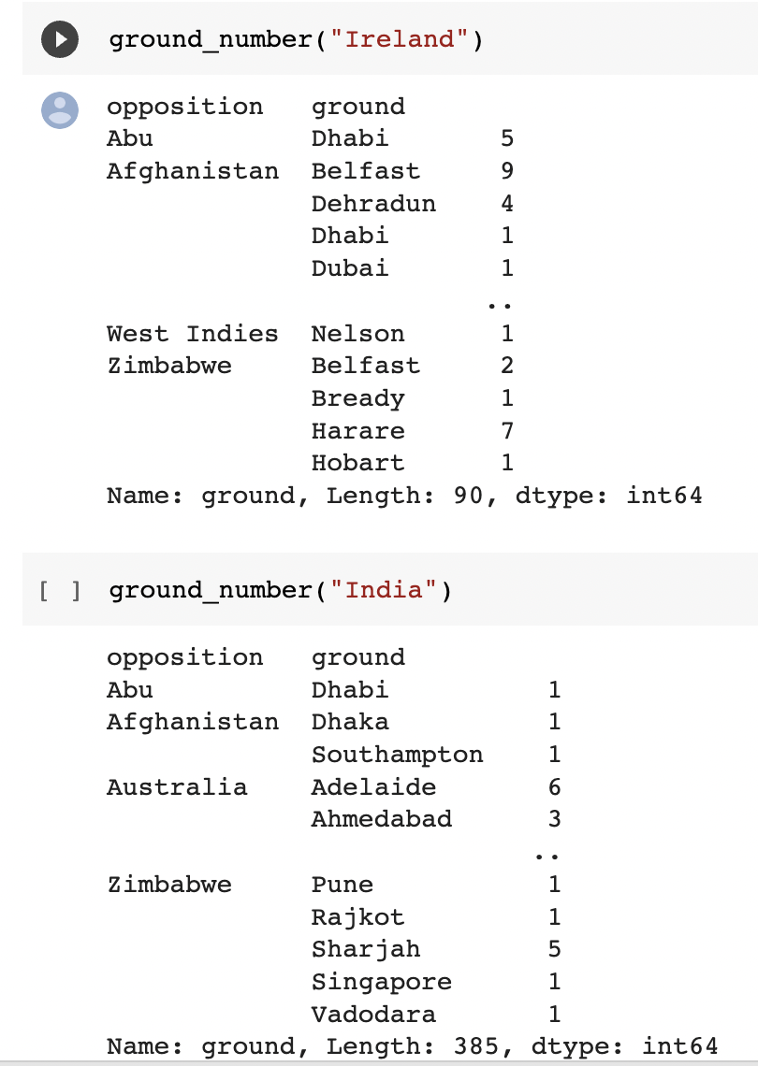
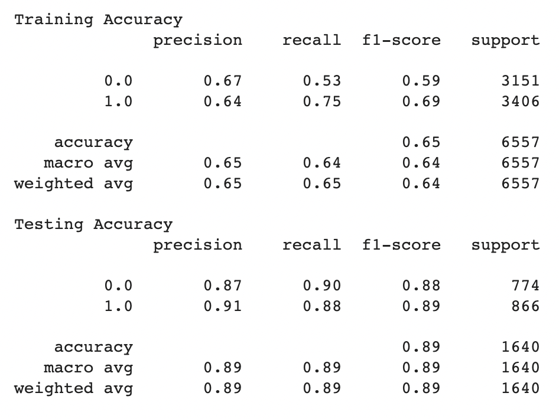
Catboost Model

Slide 12
02
Dataset

Slide 13
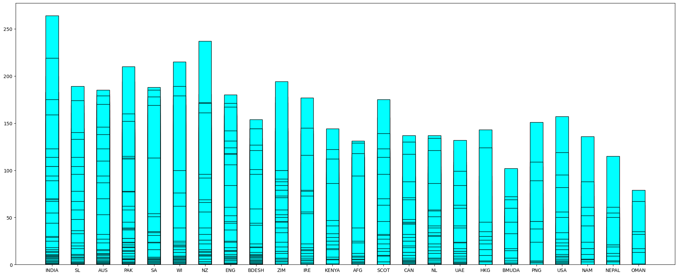
Bar Container showing number of matches played in every region

Slide 14
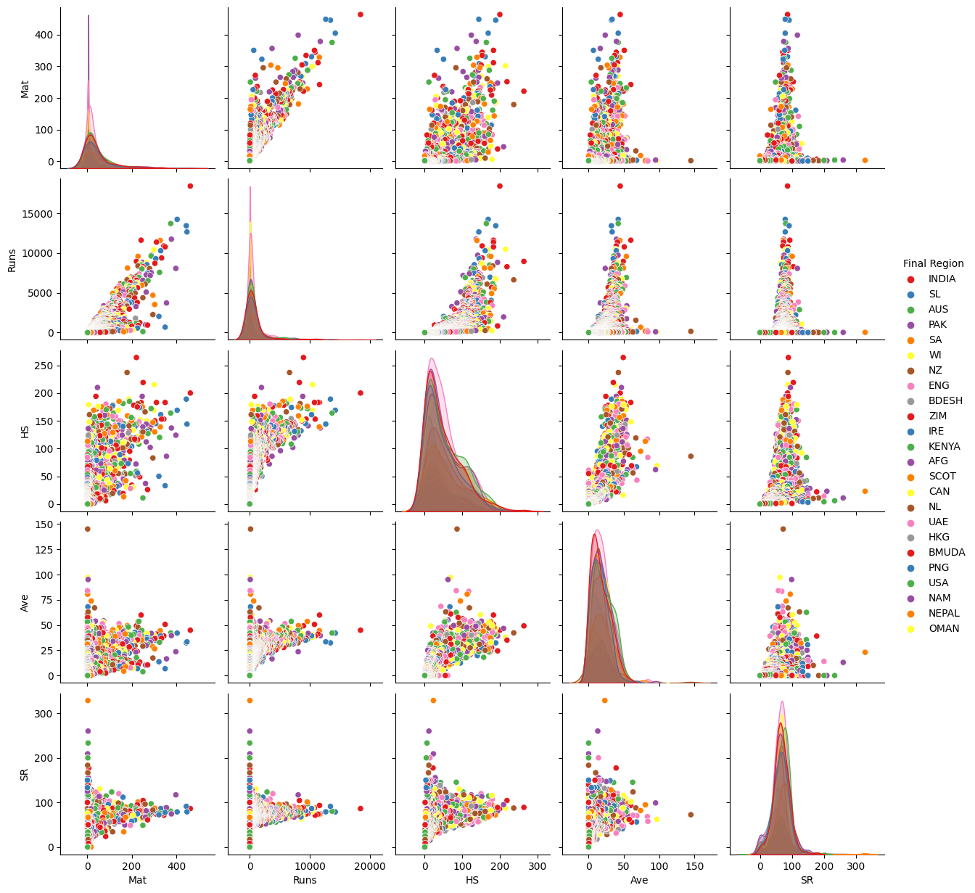
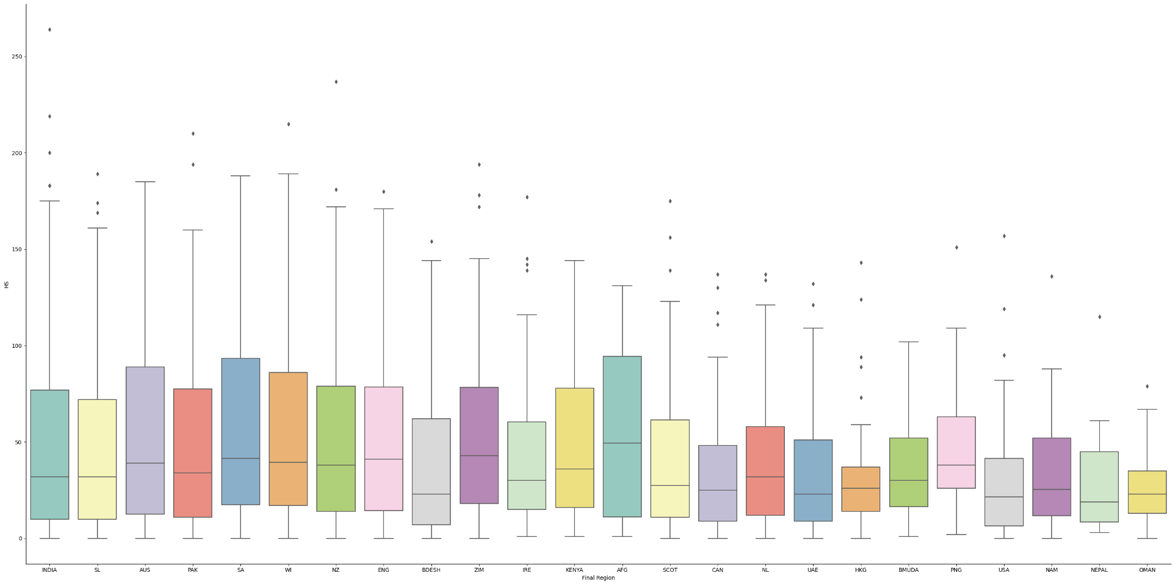
Representing number of matches,runs,HS,SR

Slide 15
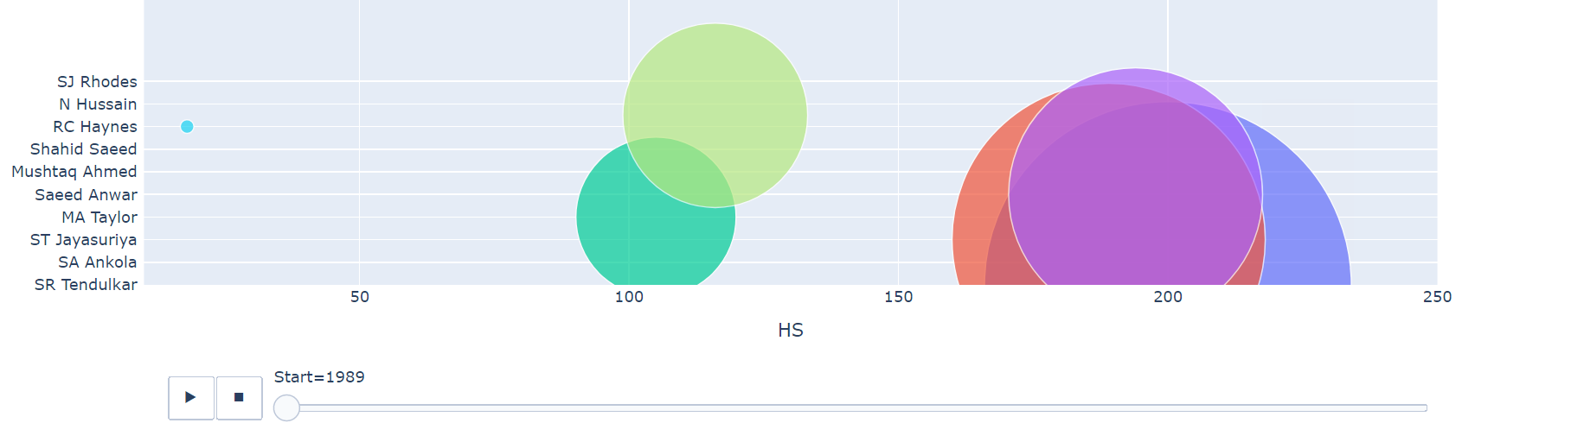
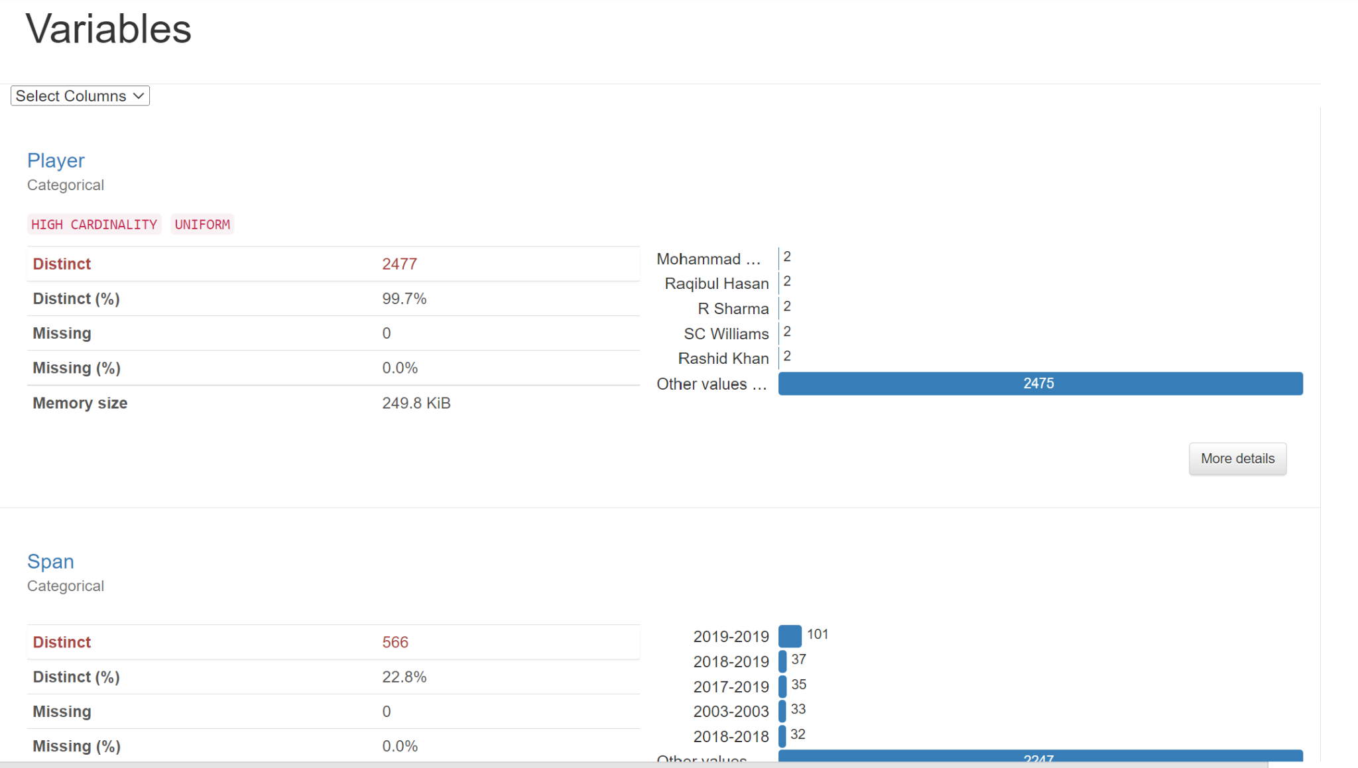
Animations(CODING FILE )

Slide 16
03
Dataset
INDIA vs AUS

Slide 17
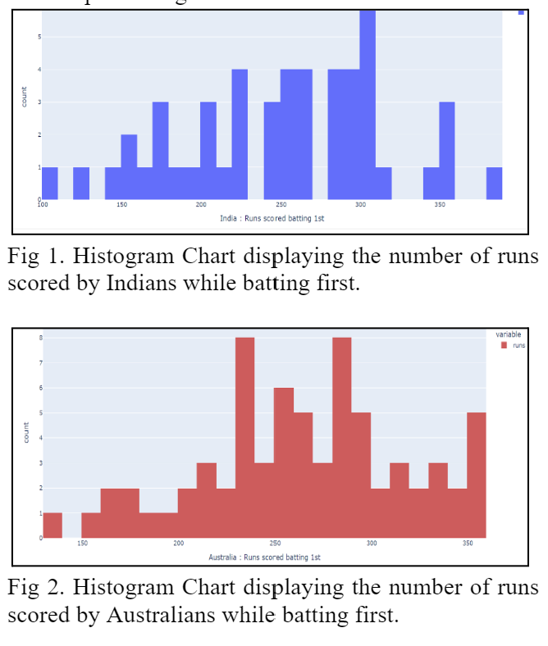
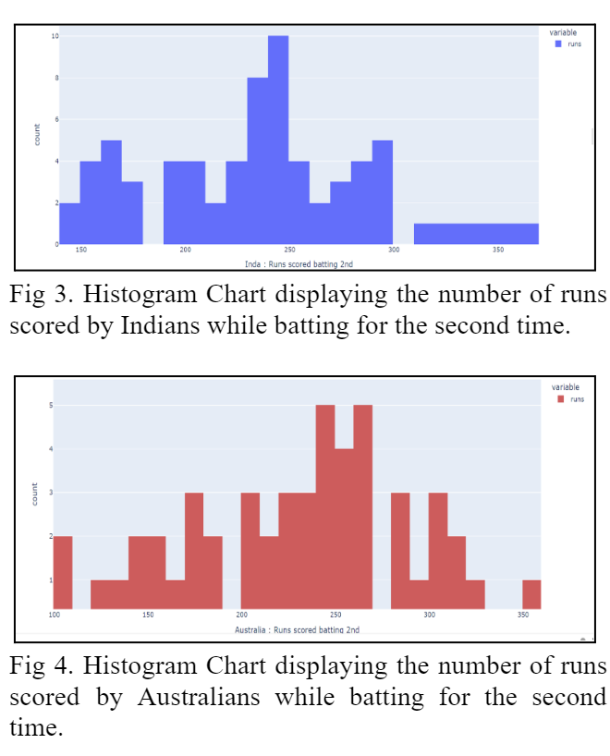

Slide 18
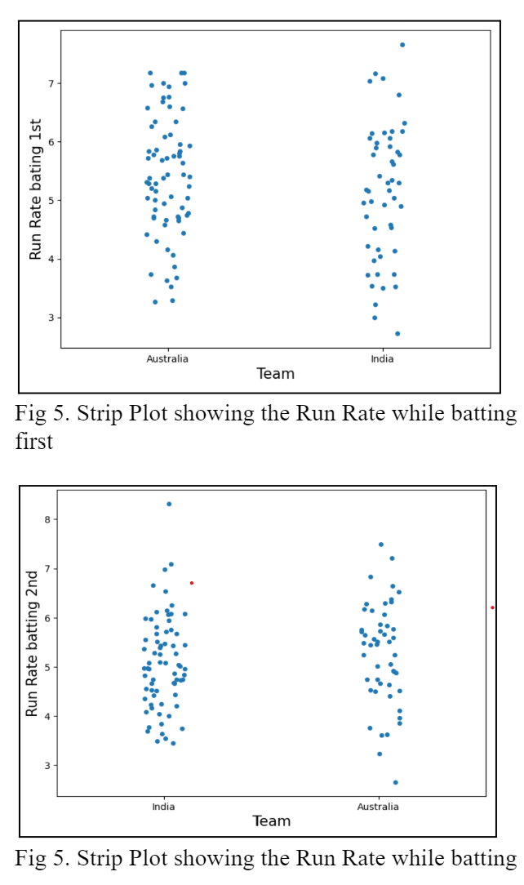
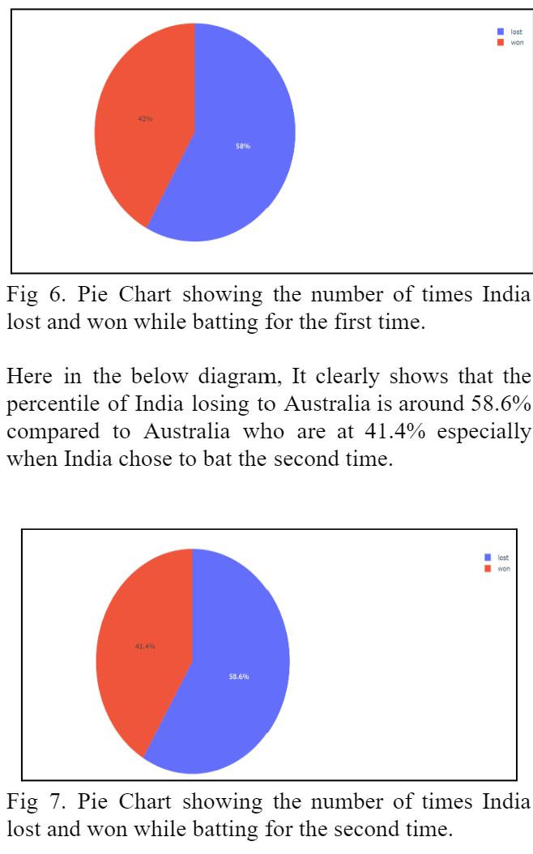

Slide 19
04
Dataset
RCB

Slide 20
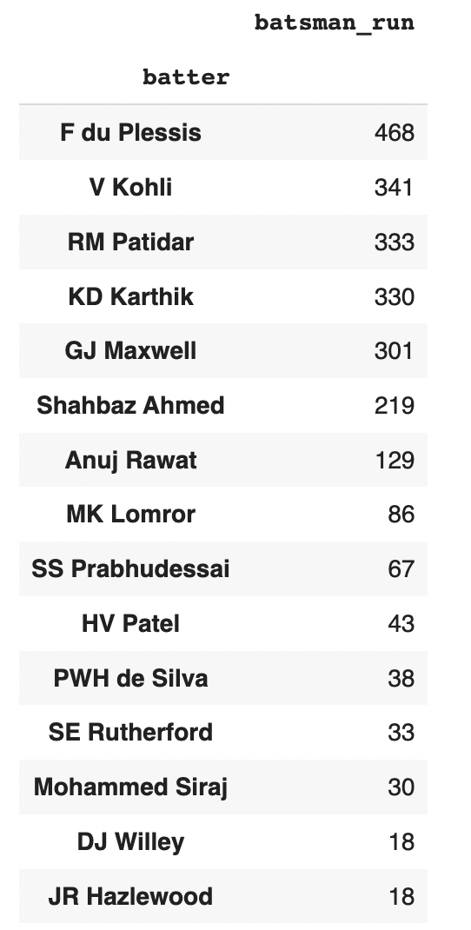
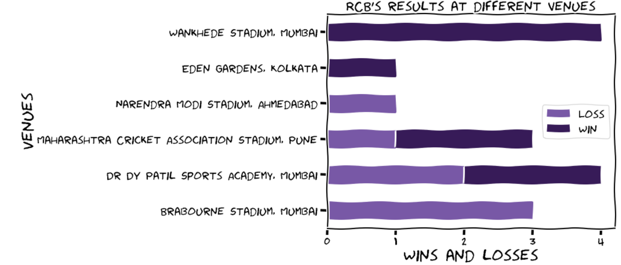

Slide 21
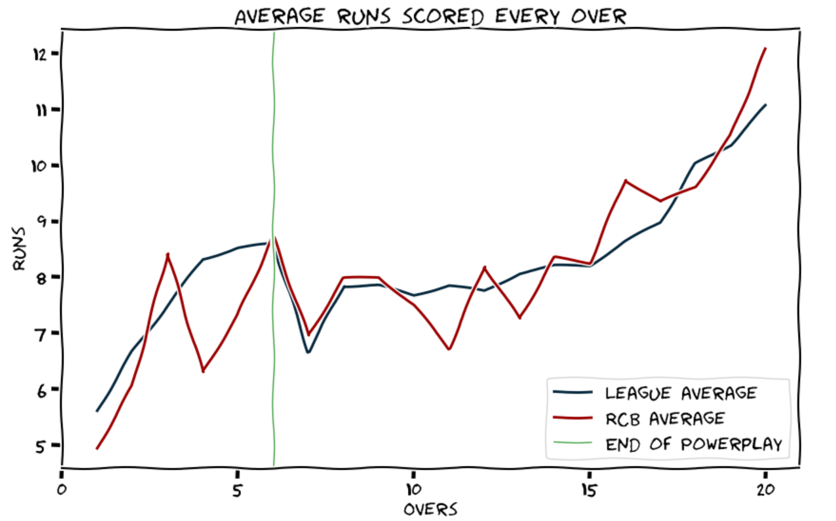

Slide 22
Thanks!

